Slide 1


EXERCISE 1 – STATE MACHINE ENGINE
Program in Python or another language a state machine engine that reads a json specification of the state machine and runs the model
Course: Formal Methods 2024/2025
Team: Federica Picca -
Alberta Motca Schnabel

Slide 2
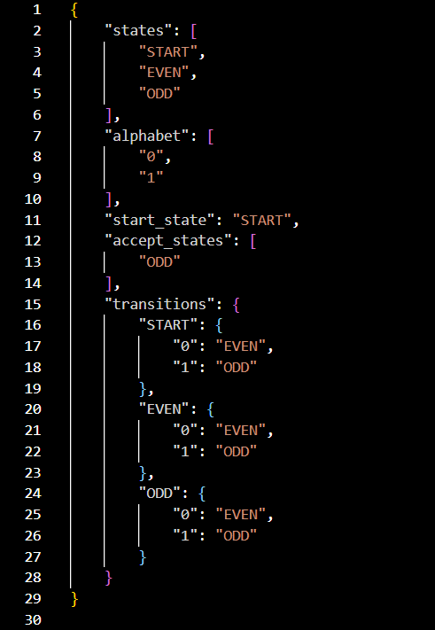
JSON SPECIFICATIONS - ODD NUMBERS
Starting from "START", this FSM reads a binary string and keeps track of whether the number of '1's is even or odd. It accepts the string if the final count of '1's is odd, ending in the "ODD" state.

Slide 3
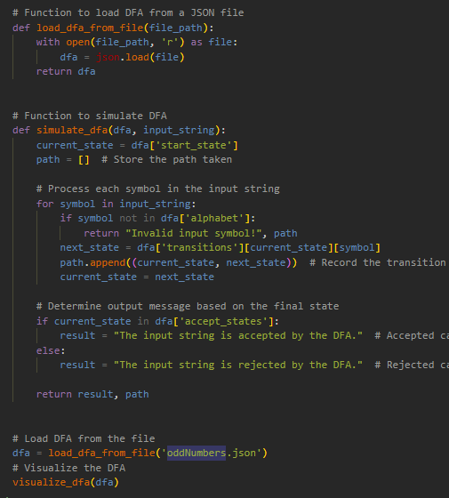
CODE - ODD NUMBERS
This code defines functions to load a DFA from a JSON file, simulate its execution on a given input string by tracking state transitions, and then return whether the input is accepted or rejected, along with the path taken through the DFA.
Reads specifications from “oddNumbers.json”

Slide 4
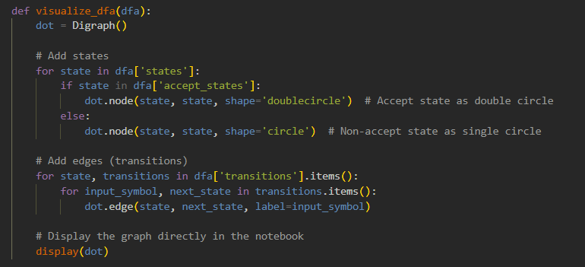
ODD NUMBERS
This function visualizes a DFA by creating a directed graph where each state is represented as a node (with double circles for accept states), and transitions are displayed as labeled edges based on input symbols, allowing the DFA structure to be displayed directly in a notebook.

Slide 5
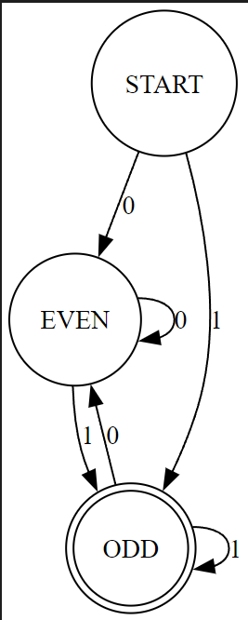
RESULT
This image represents a finite state machine that matches the code structure provided.
States: It includes three states: START, EVEN, and ODD.
Transitions:
From START, the FSM goes to EVEN on input 0 and to ODD on input 1.
In EVEN, an input of 0 keeps it in EVEN, while an input of 1 sends it to ODD.
In ODD, an input of 0 takes it to EVEN, and an input of 1 keeps it in ODD.
Acceptance: The ODD state (circled in double lines) is the accepting state, meaning the FSM accepts input sequences that end in an odd count of 1s.

Slide 6
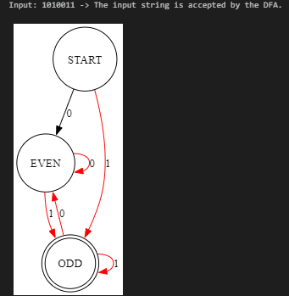
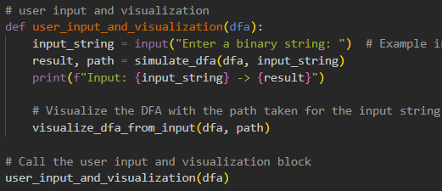
EXAMPLE WITH A GIVEN INPUT

Slide 7
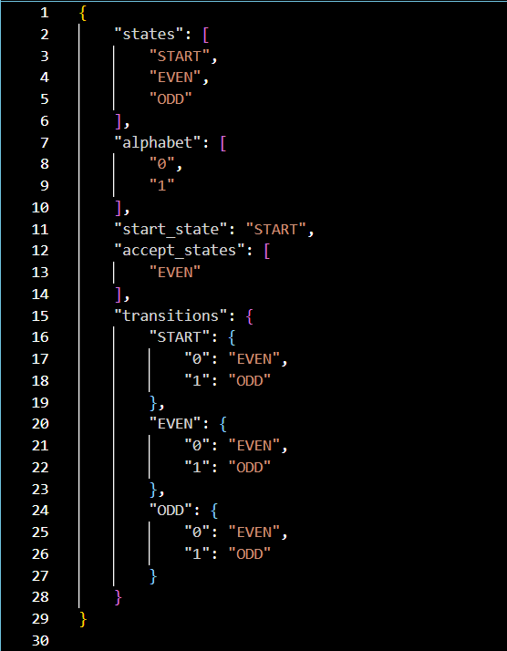
JSON SPECIFICATIONS – EVEN NUMBERS
JSON is used to clearly describe the components and behaviors of a finite state machine (FSM) in a structured format.
Starting from "START", this FSM reads a binary string and tracks whether the number of '1's is even or odd. It accepts the string if the final count of '1's is even, ending in the "EVEN" state.

Slide 8
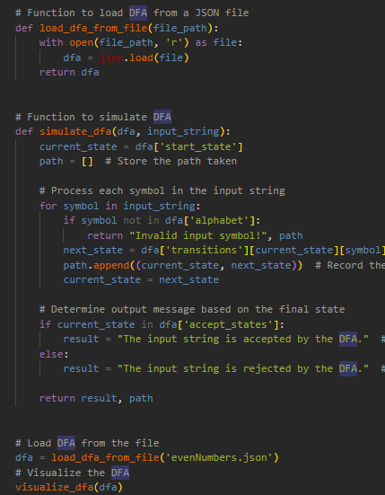
EVEN NUMBERS
In this case reads specifications from “evenNumbers.json”

Slide 9
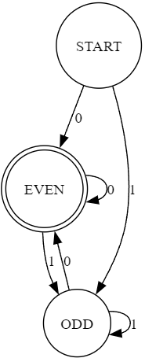
RESULT
The image represents a finite state machine (FSM) with three states: START, EVEN, and ODD.
It begins in the START state, which transitions to the EVEN state if the input is 0, or to the ODD state if the input is 1.
Once in the EVEN state, the machine remains in the same state if the input is 0, but transitions to the ODD state if the input is 1.
Similarly, in the ODD state, the machine stays in this state when the input is 1 but moves back to the EVEN state if the input is 0.

Slide 10
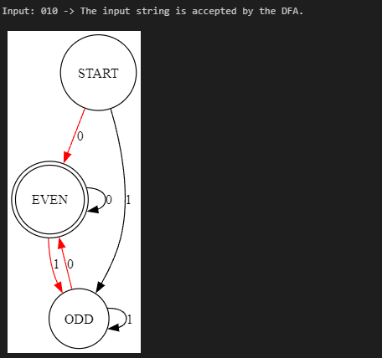
EXAMPLE WITH A GIVEN INPUT

Slide 11
THE END

